Slide 1


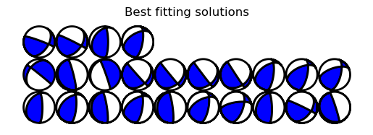
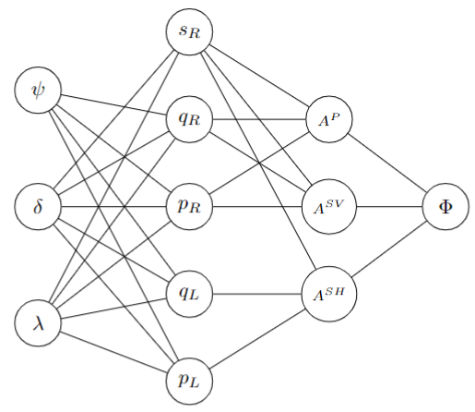
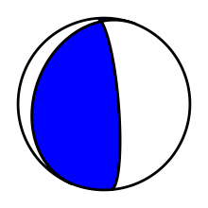
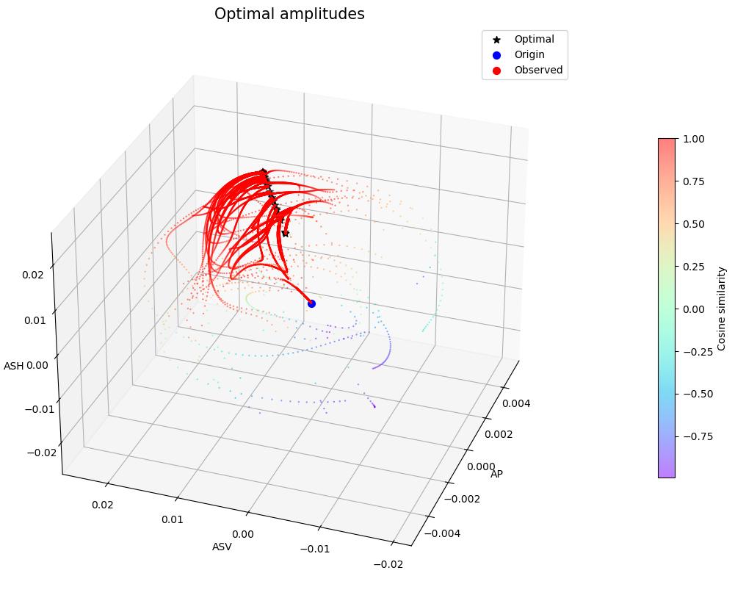
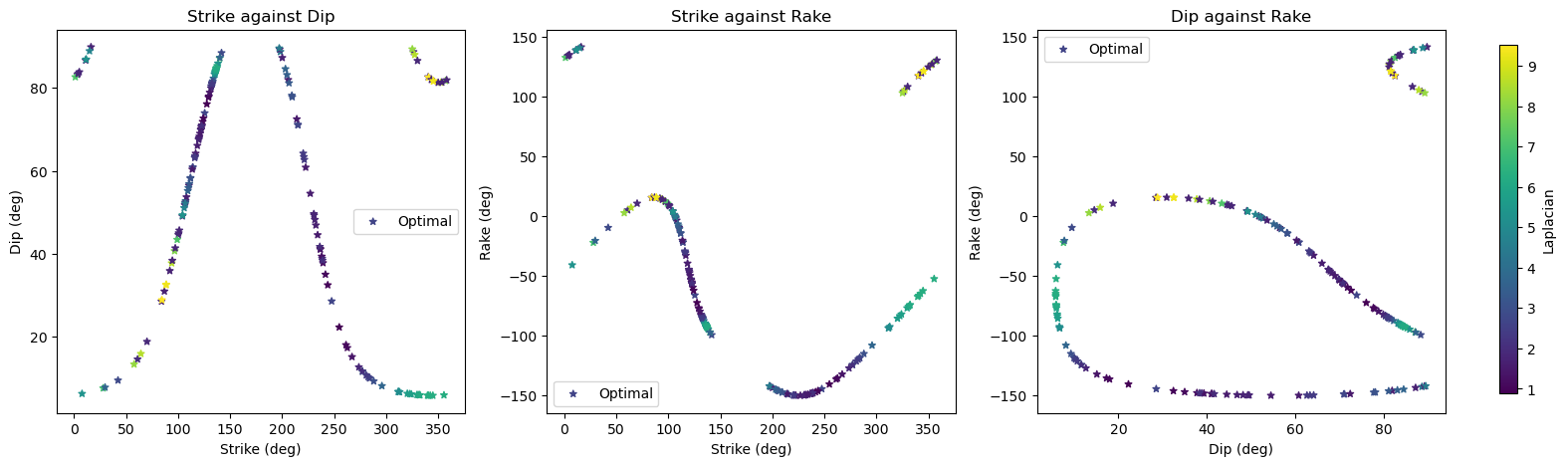
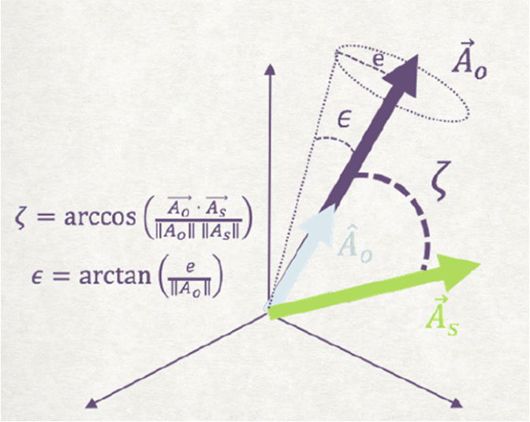
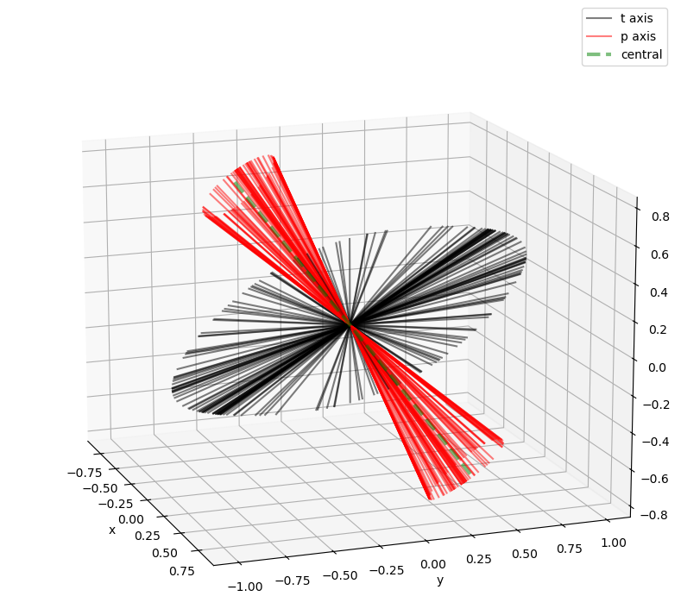
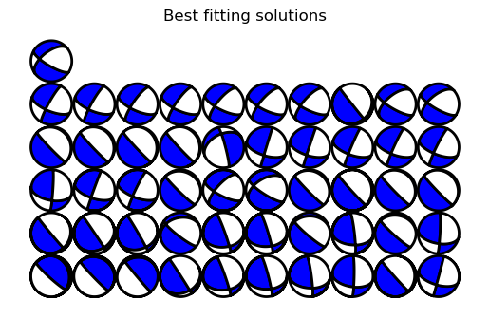
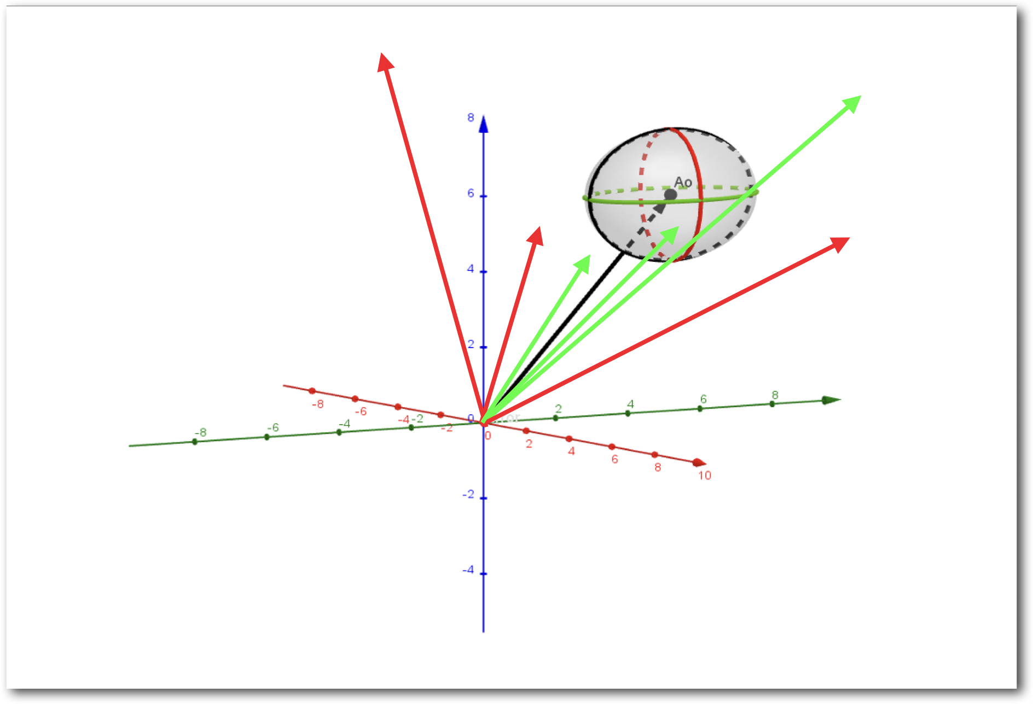
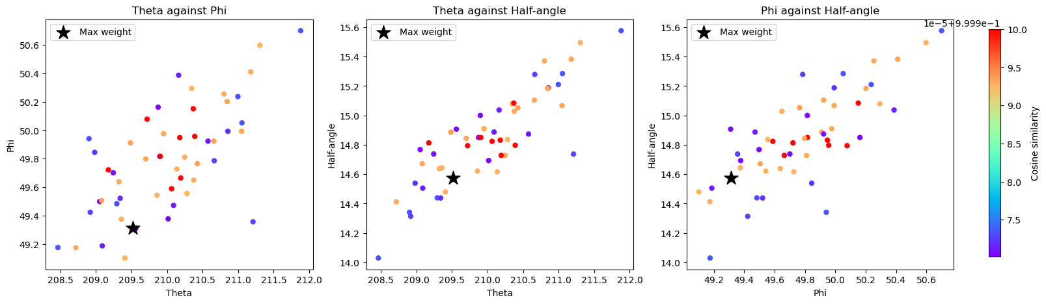
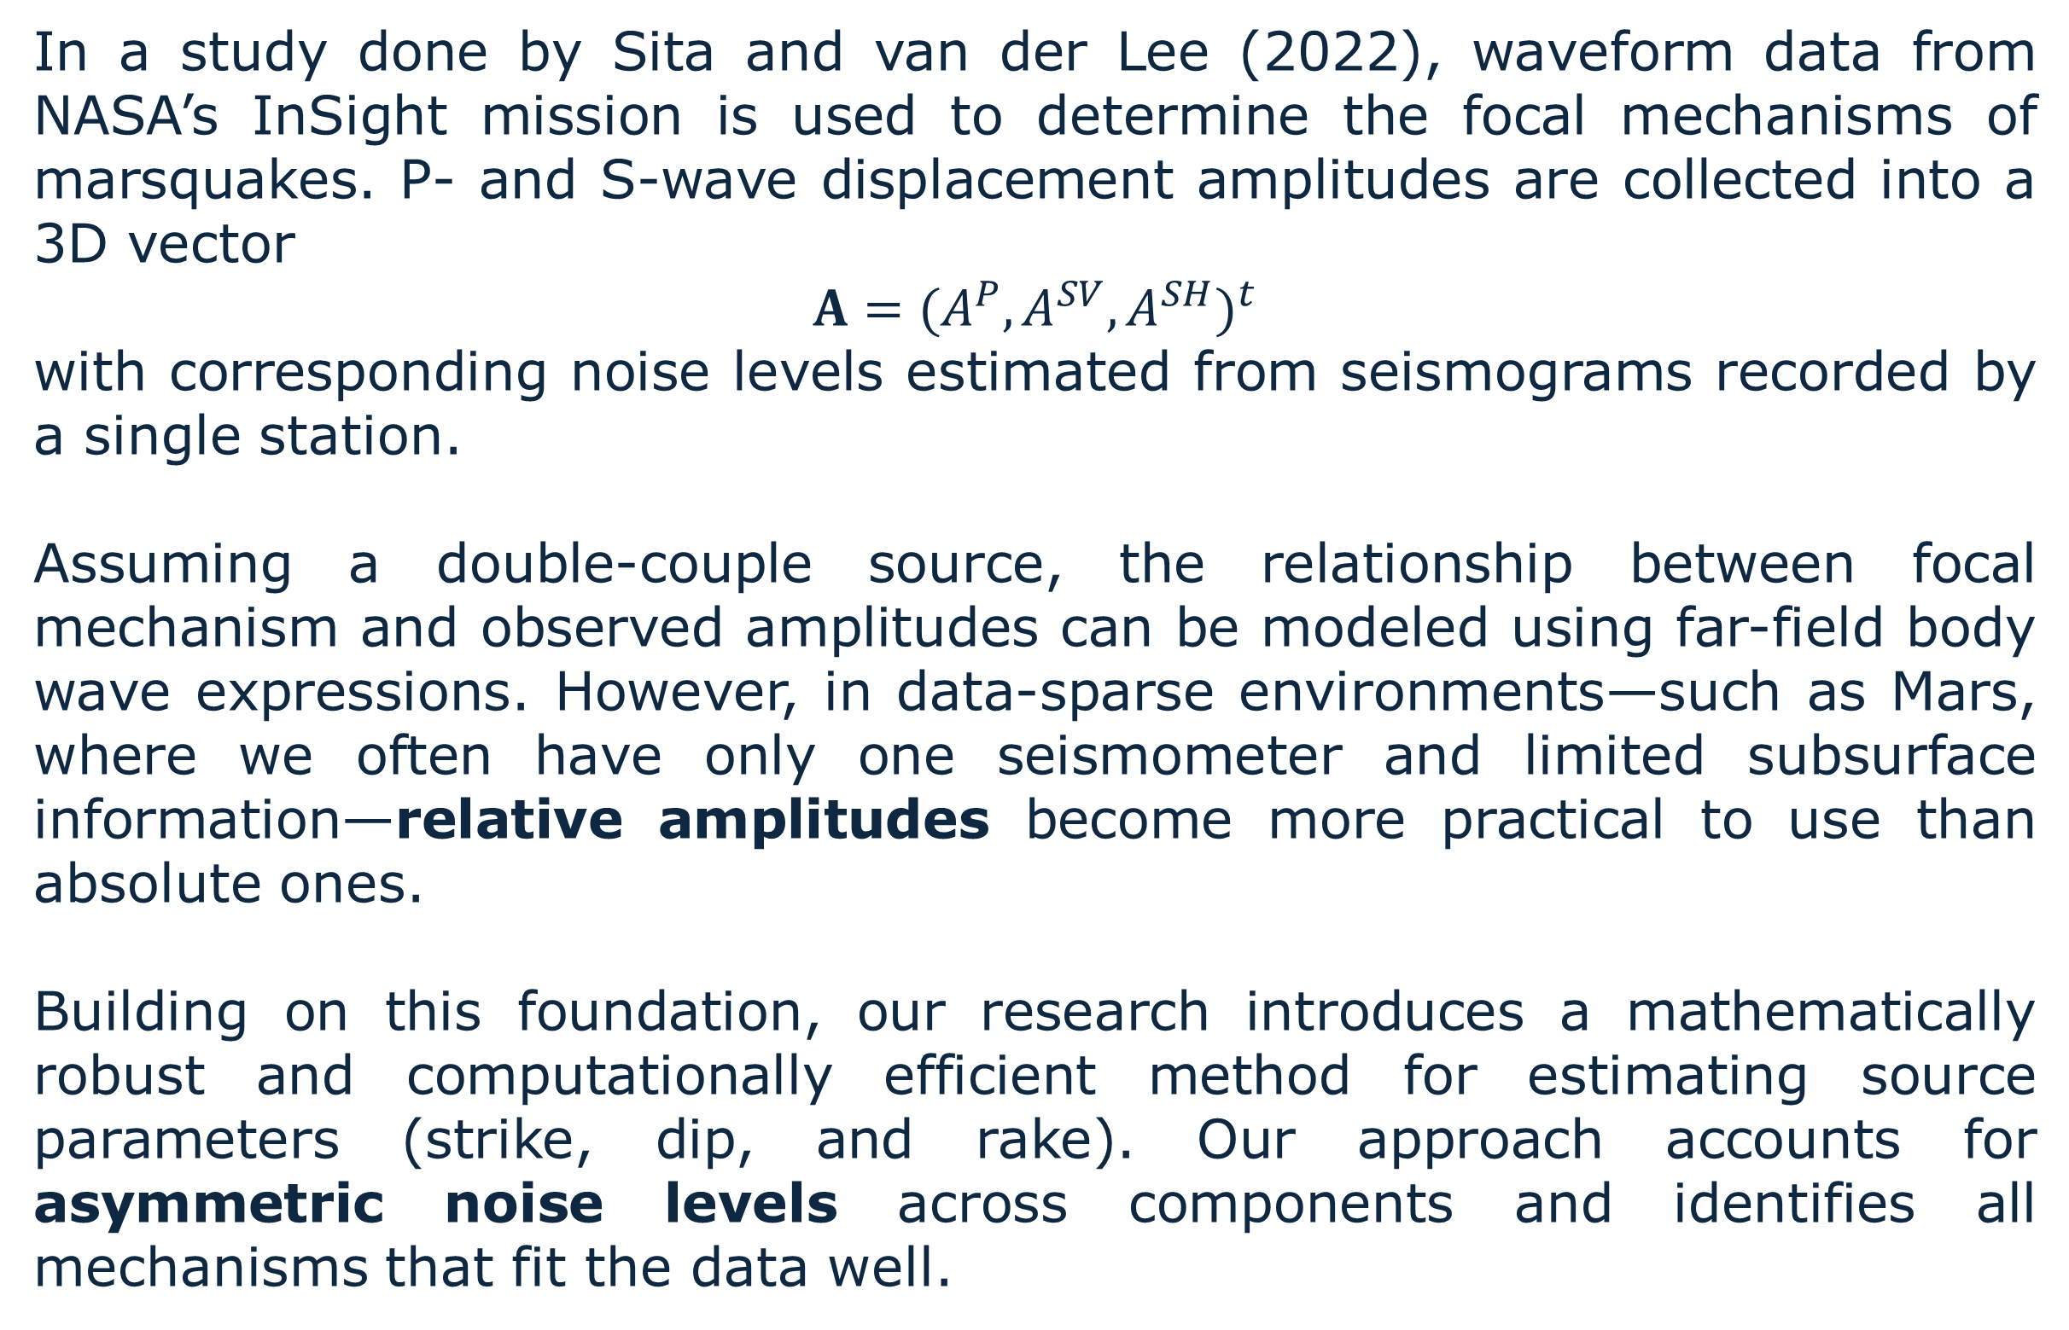
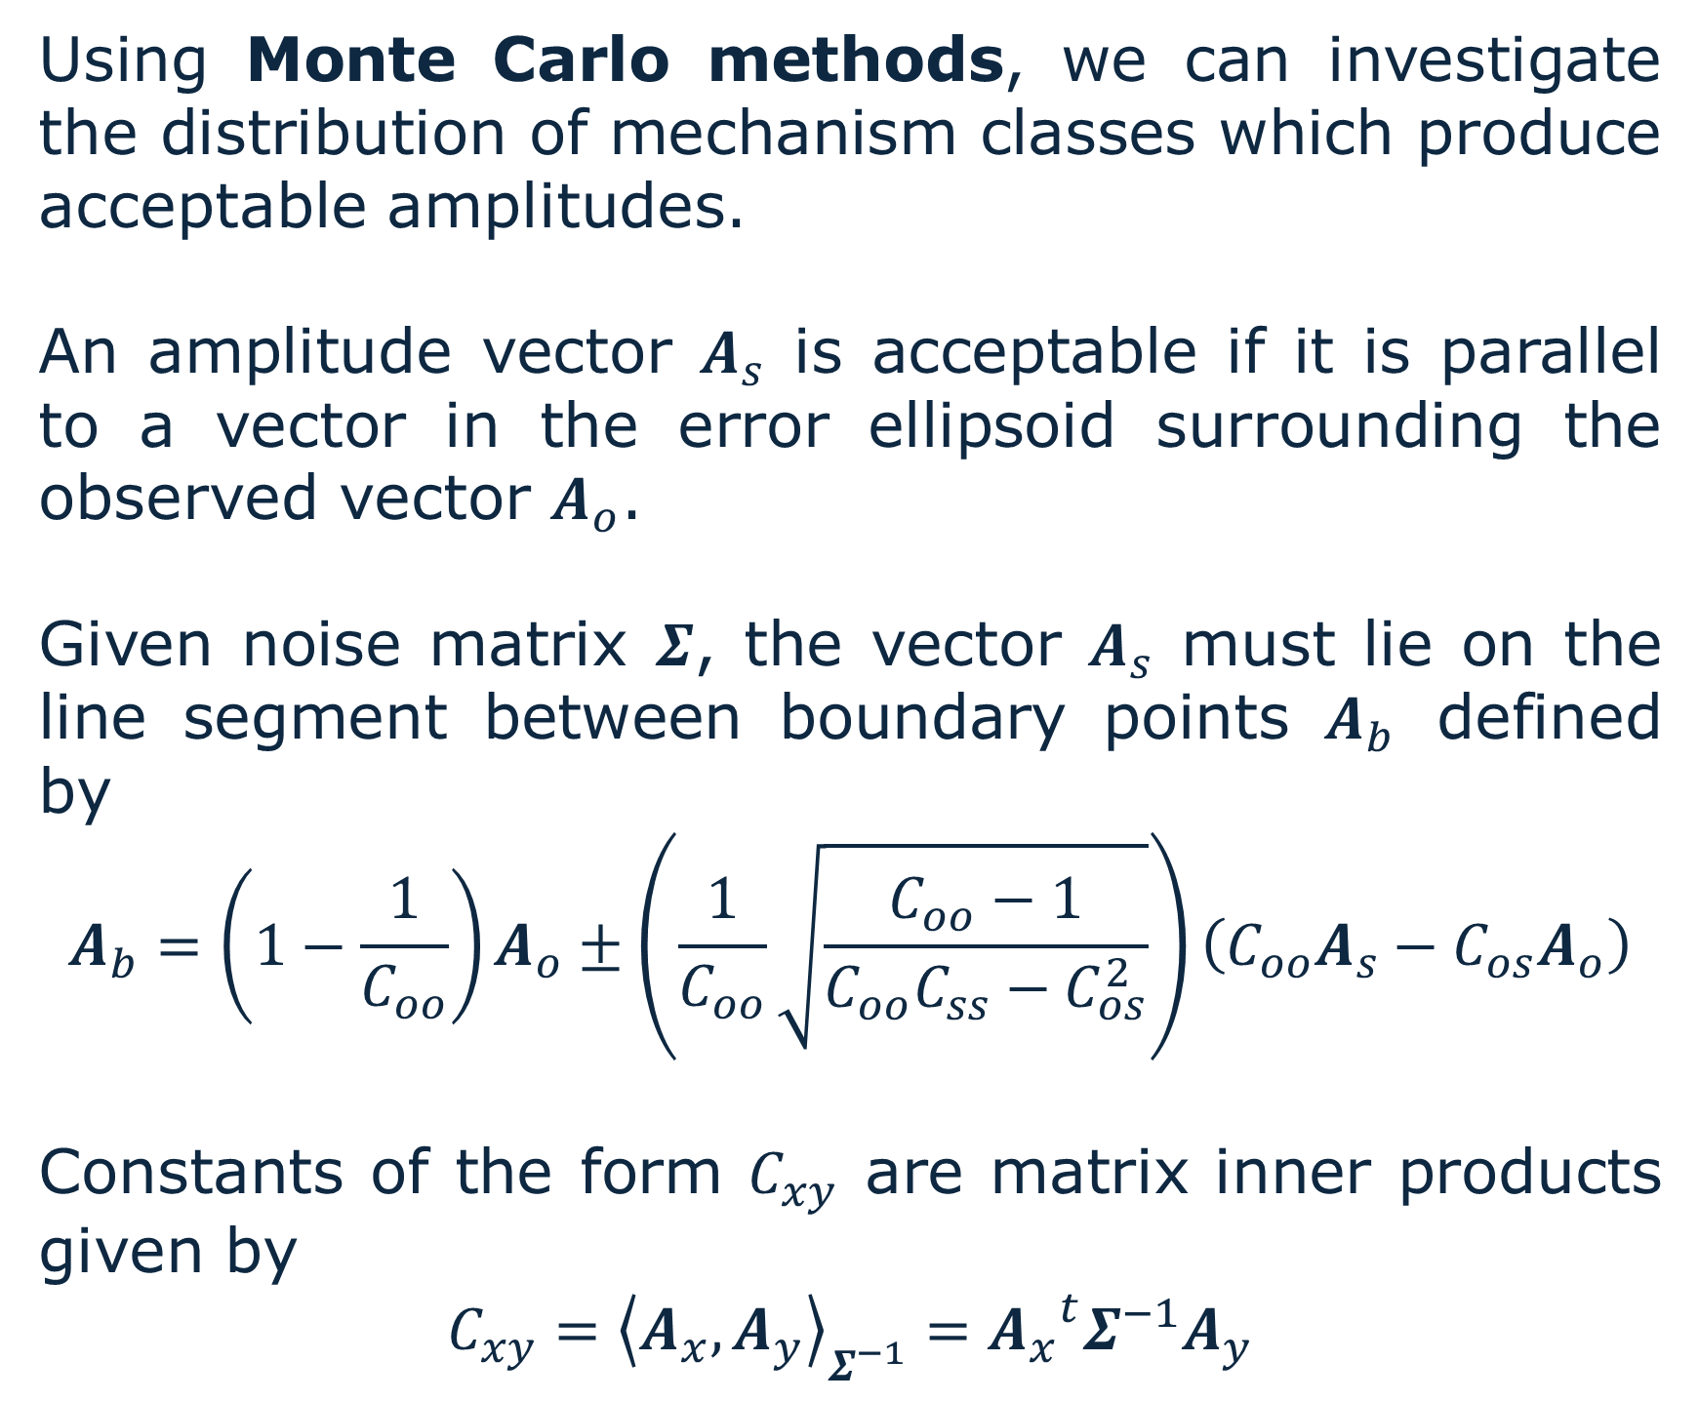
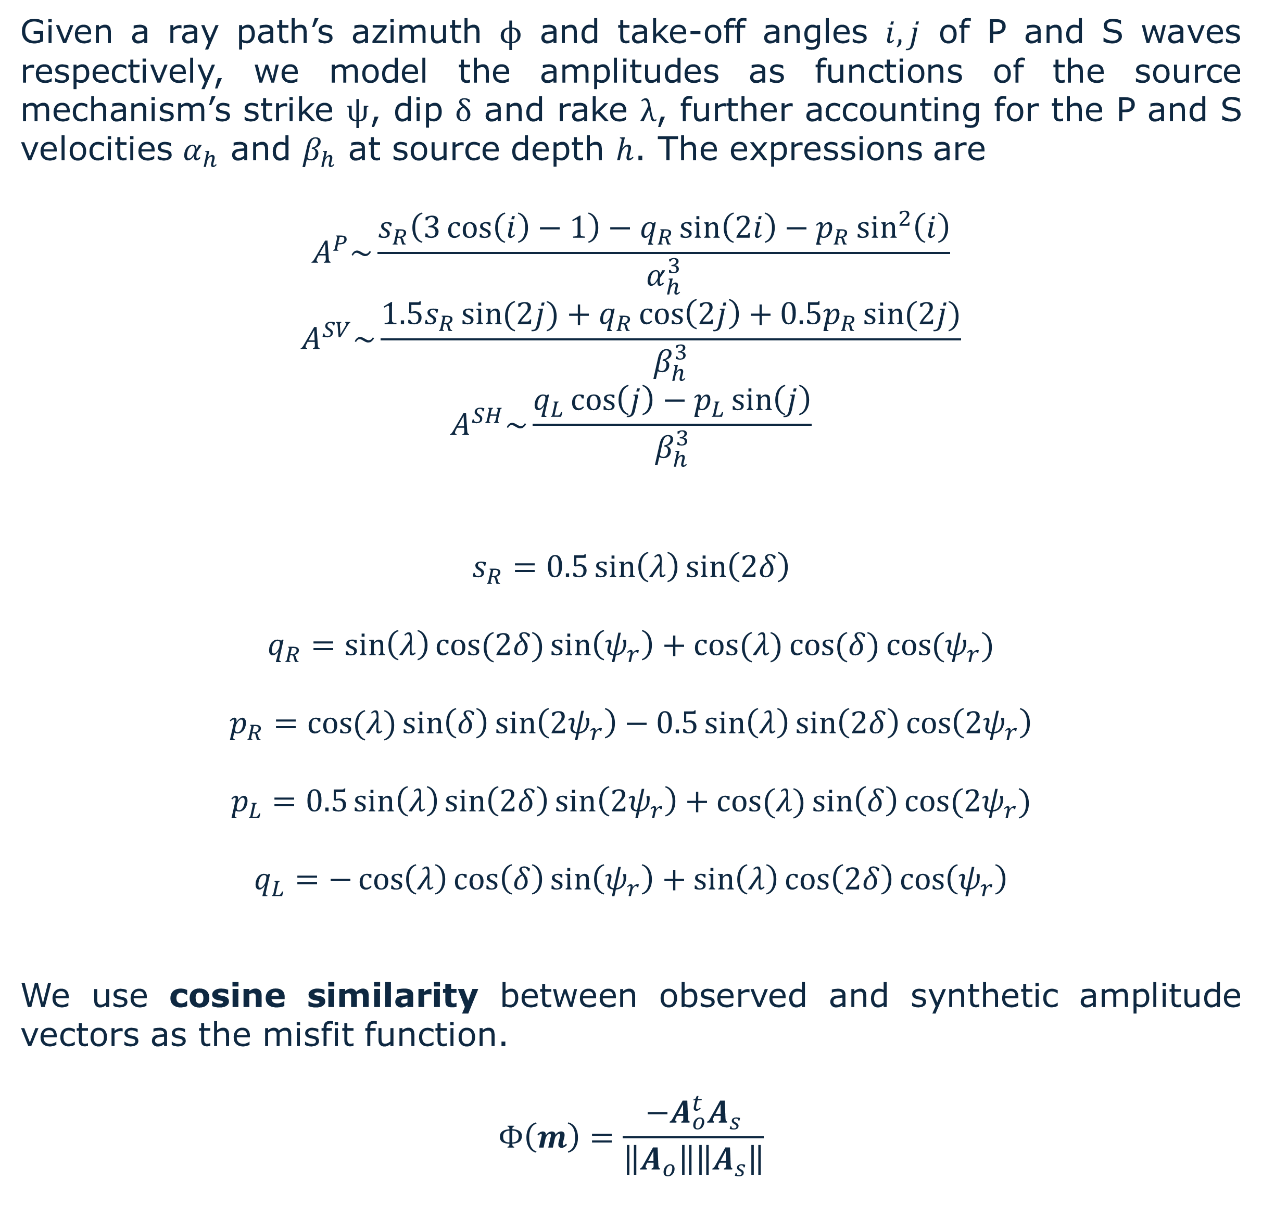
Single-seismometer Focal Mechanism and Uncertainty Estimation from Body Waves
Victor Agaba¹, Maddy Sita², Paula Babirye¹, Suzan van der Lee¹
¹ Northwestern University, ² Tulane University
Introduction & Background
Visualizations
Algorithmic Approach
In a study done by Sita and van der Lee (2022), waveform data from NASA’s InSight mission is used to determine the focal mechanisms of marsquakes. P- and S-wave displacement amplitudes are collected into a 3D vector
$$A={(A^{P}, A^{SV},A^{SH})}^{t}$$
with corresponding noise levels estimated from seismograms recorded by a single station.
Assuming a double-couple source, the relationship between focal mechanism and observed amplitudes can be modeled using far-field body wave expressions. However, in data-sparse environments—such as Mars, where we often have only one seismometer and limited subsurface information—relative amplitudes become more practical to use than absolute ones.
Building on this foundation, our research introduces a mathematically robust and computationally efficient method for estimating source parameters (strike, dip, and rake). Our approach accounts for asymmetric noise levels across components and identifies all mechanisms that fit the data well.
For a highly nonlinear multivariable misfit function whose landscape is difficult to visualize directly in 4D space, we use an algorithmic approach to parameter estimation.
Using a computational graph, we can calculate gradients by backpropagation. This makes gradient descent effective for locating local minima. By random sampling of starting points, we can trace out classes of best fitting solutions.
We found that the best-fitting mechanisms usually have a stress axis sweeping out a narrow cone. We can classify mechanisms using a three angles to describe the cone, an indicator of the axis.
Gradient descent with random starting points
Figure 1: Synthetic focal mechanism to recover.
Figure 7: Computational graph for gradient calculations.
Figure 2: Complete set of best-fitting focal mechanisms on synthetic data.
Collection 1: Using algorithmic implementation on synthetic data.
Figure 8: Demonstration of gradient descent. Optimal solutions produce amplitudes lying on a straight line.
Uncertainty Measurement
Mathematical Model
Using Monte Carlo methods, we can investigate the distribution of mechanism classes which produce acceptable amplitudes.
An amplitude vector $A_{s}$ is acceptable if it is parallel to a vector in the error ellipsoid surrounding the observed vector $A_{o}$.
Given noise matrix $Σ$, the vector $A_{s}$ must lie on the line segment between boundary points $A_{b}$ defined by
$$A_{b}=\left(1−\frac{1}{C_{oo}}\right)A_{o}±\left(\frac{1}{C_{oo}}\sqrt{\frac{C_{oo}−1}{C_{oo}C_{ss}−C_{os}^{2}}}\right)\left(C_{oo}A_{s}−C_{os}A_{o}\right)$$
Constants of the form $C_{xy}$ are matrix inner products given by
$$C_{xy}={\left\langle A_{x},A_{y}\right\rangle }_{Σ^{−1}}={A_{x}}^{t}Σ^{−1}A_{y}$$
Figure 3: Complete set of best-fitting solutions in strike-dip-rake space. Both fault planes are included, so each solution appears with its mirror image.
The Laplacian, estimated using finite differences, gives information about local curvature for each solution.
Given a ray path’s azimuth $ϕ$ and take-off angles $i,j$ of P and S waves respectively, we model the amplitudes as functions of the source mechanism’s strike $ψ$, dip $δ$ and rake $λ$, further accounting for the P and S velocities $α_{h}$ and $β_{h}$ at source depth $h$. The expressions are
$$A^{P}\sim \frac{s_{R}\left(3\cos\left(i\right)−1\right)−q_{R}\sin\left(2i\right)−p_{R}\sin^{2}\left(i\right)}{α_{h}^{3}}$$
$$A^{SV}\sim \frac{1.5s_{R}\sin{(2j)}+q_{R}\cos\left(2j\right)+0.5p_{R}\sin{(2j)}}{β_{h}^{3}}$$
$$A^{SH}\sim \frac{q_{L}\cos\left(j\right)−p_{L}\sin\left(j\right)}{β_{h}^{3}}$$
$$s_{R}=0.5\sin\left(λ\right)\sin\left(2δ\right)$$
$$q_{R}=\sin\left(λ\right)\cos{(2δ)}\sin\left(ψ_{r}\right)+\cos{(λ)}\cos{(δ)}\cos{(ψ_{r})}$$
$$p_{R}=\cos{(λ)}\sin\left(δ\right)\sin\left(2ψ_{r}\right)−0.5\sin\left(λ\right)\sin\left(2δ\right)\cos\left(2ψ_{r}\right)$$
$$p_{L}=0.5\sin\left(λ\right)\sin\left(2δ\right)\sin\left(2ψ_{r}\right)+\cos{(λ)}\sin\left(δ\right)\cos{(2ψ_{r})}$$
$$q_{L}=−\cos\left(λ\right)\cos\left(δ\right)\sin\left(ψ_{r}\right)+\sin\left(λ\right)\cos\left(2δ\right)\cos\left(ψ_{r}\right)$$
We use cosine similarity between observed and synthetic amplitude vectors as the misfit function.
$$Φ\left(m\right)=\frac{−A_{o}^{t}A_{s}}{\left\|A_{o}\right\|\left\|A_{s}\right\|}$$
Figure 9: Old method for uncertainty quantification using spherical approximation does not account for asymmetry.
Figure 10: New method for uncertainty quantification accounts for asymmetry using noise ellipsoids.
Figure 4: Complete set of best-fitting solutions visualized in T-axis (black) and P-axis (red) space. Each solution corresponds to exactly one pair of orthogonal axes. The P-axes sweep out a narrow cone.
Figure 5: Complete set of best-fitting solutions visualized as beachballs.
Conclusion
Collection 2: Using algorithmic approach on earthquake data from MBAR, Uganda.
When using a single seismometer and in data-sparse settings, our methodology is more reliable in:
Accuracy: It can characterize entire classes of best-fitting mechanisms, which a grid search cannot do.
Efficiency: Gradient descent is much faster than brute force inverse methods, and it makes use of the gradient information available.
Robustness: It respects any asymmetries in measured noise levels for P and S waves without any major tradeoffs.
However, we have highly nonlinear transformations which make the method less reliable at low signal-noise ratios.
Figure 6: Distribution of acceptable mechanism classes accounting for asymmetric noise. Each point describes a “cone” of mechanisms using angular parameters. For higher signal-noise ratios, the effect of nonlinearity is minimized.
References:
Sita, M., and S. van der Lee, Potential Volcano-Tectonic origins and Faulting Mechanisms of Three Low-Frequency Marsquakes Detected by a Single Insight Seismometer, JGR Planets, doi:10.1029/2022JE007309, 2022.
Agaba, V., M. Sita, and S. van der lee, Tolerance Estimation of Marsquake Wave Amplitudes, AGU Fall Meeting, Chicago, 2022.
This material is based in part upon work supported by Northwestern University via a Summer Undergraduate Research Grant to Victor Agaba and a National Science Foundation REU Grant, to Madelyn Sita, via CIERA.
Collection 3: Using Monte Carlo experiment to observe distribution of all classes of mechanisms that produce acceptable amplitude vectors.

